Slide 1
Files In Python

Slide 2
DEFINITION
File is a named location on disk to store related information. It is used to permanently store data in a non-volatile memory (e.g. hard disk).
Since, random access memory (RAM) is volatile which loses its data when computer is turned off, we use files for future use of the data.
In Python, a file operation takes place in the following order.
  Open a file
  Read or write (perform operation)
  Close the file

Slide 3
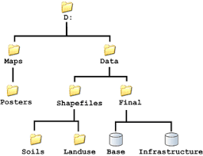
FILE PATH
Every file is identified by its path that begins from root node or folder.
File Path may be relative or absolute
Absolute path :D:\Data\Final\Base
Relative path : Base

Slide 4
TYPES OF FILES
Support two types of files.
Text File: Sequence of characters that is processed by computer . Each line of text file ends with a newline character. Each file ends with special character called EOF character.
Binary File: The contents of binary file are not in human readable format
If we want the data to be in human readable format,then store it as text file
Binary files are mainly used to store images and executable files

Slide 5
Open a File
Parameters detail:
file_name: The file_name argument is a string value that contains the name of the file that you want to access.
access_mode: The access_mode determines the mode in which the file has to be opened i.e. read, write append etc. This is optional parameter and the default file access mode is read (r)

Slide 6
Mode | Description
‘r’ | Read
‘w’ | Write
‘a’ | Appending
‘r+’ | Read+Write
‘w+’ | Read+Write If file not exists a new file is created for read and write If file already exists the contents is overwritten
‘a+’ | Read+Append If file not exists a new file is created for read and write If file already exists the new contents will be appended
‘rb’ | Read only in binary format
‘wb’ | Write only in binary format
‘ab’ | Opens a file in binary format for appending
‘rb+’ | Read+Write in binary format
‘wb+’ | Read+Write (binary format) If file not exists a new file is created for read and write If file already exists the contents is overwritten
‘ab+’ | Read+Append (binary format) If file not exists a new file is created for read and write If file already exists the new contents will be appended

Slide 7
Syntax to Open a File
fileobj = open(filename, mode)
fp = open(“py.txt”, “w”)
print(fp)
Creates a text file named py.txt in write mode in the relative path.
Output:
<_io.TextIOWrapper name='py.txt' mode='w' encoding='cp1252'>

Slide 8
Syntax to Open a File
fileobj = open(filename, mode)
fp = open(“D:\py.txt”, “w”)
print(fp)
Creates a text file named py.txt in write mode in the path Absolute path (D:\).
Output:
<_io.TextIOWrapper name='D:\\py.txt' mode='w' encoding='cp1252'>

Slide 9
File Object Attributes
Once a file is opened and you have one file object, you can get various information related to that file.
Here is a list of all attributes related to file object:
Attribute | Description
file.closed | Returns true if file is closed, false otherwise.
file.mode | Returns access mode with which file was opened.
file.name | Returns name of the file.

Slide 10
Example:
fp = open("D:\py.txt", "r")
print(fp.closed)
print(fp.name)
print(fp.mode)
OUTPUT:
  False
  D:\py.txt
  r

Slide 11
Closing a File
close() Method:
The close() method is used to close the file object. Once you close the file object you can not do any operations like read or write.
Syntax:
fileObj.close()
Example:
fp = open("D:\py.txt", "r")
fp.close()
print(fp.closed)
print(fp.read())
Output:
True
Traceback (most recent call last):
File "C:/Users/english/Desktop/aa.py", line 4, in <module>
print(fp.read())
ValueError: I/O operation on closed file.

Slide 12
write()and writelines() append read() and readline() opening files using with keyword splitting words
READING AND WRITING FILES

Slide 13
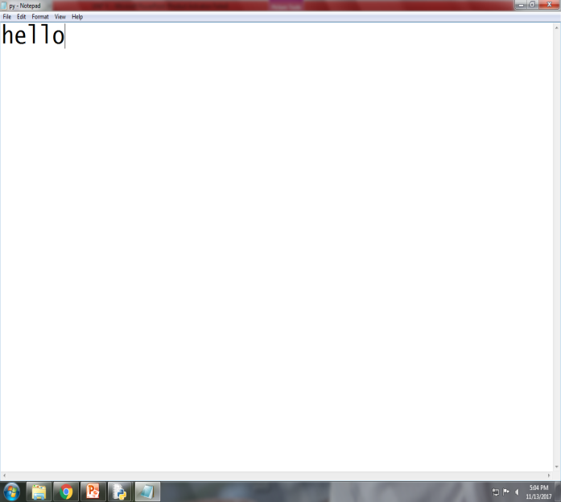
write()
Write()
Syntax: fileobj.write(“String”)
Example:
fp = open("D:\py.txt", "w+")
fp.write("hello")
print("File is successfully written")
fp.close()
Output:
File is successfully written
Snap shot

Slide 14
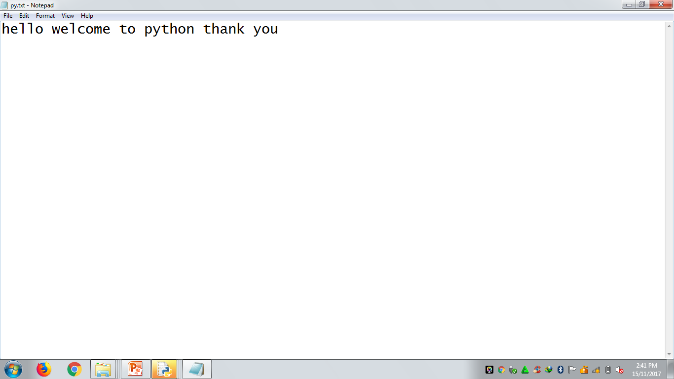
writelines()
writelines()
This method is used to write a list of strings
Example:
fp = open("py.txt", "w+")
l=["hello ","welcome to python ","thank you"]
fp.writelines(l)
print("File is successfully written")
fp.close()
Output:
File is successfully written

Slide 15
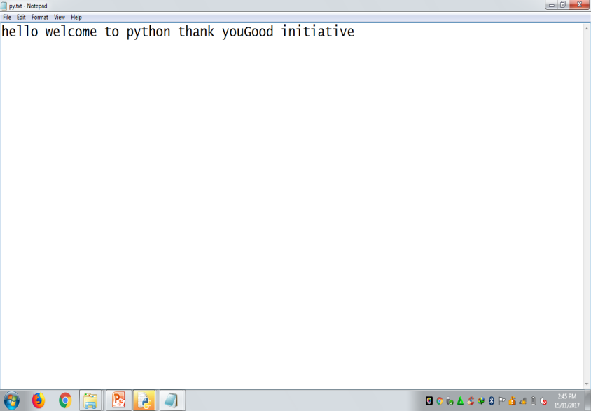
append
To append a file we must open by using ‘a’ or ’ab’ depending on whether it is a text file or binary file
Example:
fp = open("py.txt", “a")
fp.write(“Good initiative“)
print("File is appended")
fp.close()
Output:
File is appended
***If you open a file in append mode then the file is created if it does not exist

Slide 16
read()
Reads the content of a file until EOF is encountered
read()
Syntax: fileobj.read()
Example 1:
fp = open("py.txt", "r")
print(fp.read())
print("File is read successfully")
fp.close()
Output:
hello welcome to python thank youGood initiative
File is read successfully
*** returns an error if the file is not present

Slide 17
read(n)
Reads up to particular number of bytes from the opened file.
read(n)
Syntax: fileobj.read(n)
This function is used to the n number of bytes from a file
Example 2:
fp = open("py.txt", "r")
print(fp.read(5))
print("File is read successfully")
fp.close()
Output:
hello
File is read successfully
*** returns an error if the file is not present

Slide 18
readline()
Reads the content of file line by line
Syntax: fileobj.readline()
Example 1:
fp = open("py.txt", "r")
print("First line", fp.readline())
print("Second line",fp.readline())
print("Third line",fp.readline())
fp.close()
Output:
First line Hello
Second line Good initiative
Third line Thank you
*** returns an error if the file is not present

Slide 19
readlines()
Reads the content of file line by line and convert it as list with a newline character between lines
Syntax: fileobj.readlines()
Example:
fp = open("py.txt", "r")
print(fp.readlines())
fp.close()
Output:
['Hello\n', 'Good initiative\n', 'Thank you']
*** returns an error if the file is not present

Slide 20
Opening files using with keyword
When you forget to close the file explicitly it will automatically closes the file after file operations while you open the file using with keyword
Example:
with open ("py.txt", "r") as f:
for line in f:
print(line)
print(f.closed)
Output:
Hello
Good initiative
Thank you
TRUE

Slide 21
Splitting Words
It reads the lines of a file and splits the line into words based on a character. Default character for splitting the words in “ “.
Example 1:
with open ("py.txt", "r") as f:
line=f.readline()
words=line.split(" ")
print(words)
Output:
['Hello', 'Good', 'initiative', 'Thank', 'you']

Slide 22
Some other Useful file methods
Method | Description | Example | Output
fileno() | Return the file number of a file | f=open("py.txt","r") print(f.fileno()) | 3
flush() | Flushes the write buffer of the filestream | f=open("py.txt","r") print(f.flush()) | None
isatty() | Return true if file stream is interactive and return false otherwise | f=open("py.txt","w") f.write("Hello") print(f.isatty()) f.close() | False
readline(n) | Return one line from file | f=open("py.txt","r") print(f.readline(6)) print(f.readline(5)) | Hello Good
truncate() | Resizes the file to n bytes | f=open("py.txt","w") f.write("Hello Welcome to all") f.truncate(7) f=open("py.txt","r") print(f.read()) f.close() | Hello W

Slide 23
Some other Useful file methods
Method | Description | Example | Output
truncate() | Resizes the file to n bytes | f=open("py.txt","w") f.write("Hello Welcome to all") f.truncate(7) f=open("py.txt","r") print(f.read()) f.close() | Hello W
rstrip() | Strips off white spaces including newline character from right side of the string read from file | f=open("py.txt","w") f.write("Hello How are u \n\n") f=open("py.txt","r") l=f.read() print(l.rstrip()) f.close() | Hello How are u

Slide 24
File Positions
Python has various methods that tell and set the position of the file pointer
Tell- returns the current position of file pointer
Syntax:fileptr.tell()
Seek- used to set the position of file pointer to a new location
Syntax:fileptr.seek(offset[,from])
from argument has three values
From | position
0 | From beginning of file
1 | From current position of file
2 | From end of file

Slide 25
Example for set and tell
PROGRAM:
f=open("py.txt","w")
f.write("Hai hello how are u")
print("current position ",f.tell())
f.close()
f=open("py.txt","r") OUTPUT:
print("current position ", f.tell()) current position 19
print(f.read(3)) current position 0
print("now position ", f.tell()) Hai
print("after moving") now position 3
f.seek(14,0) after moving
print("content is ", f.read()) content is are u
f.close()

Slide 26
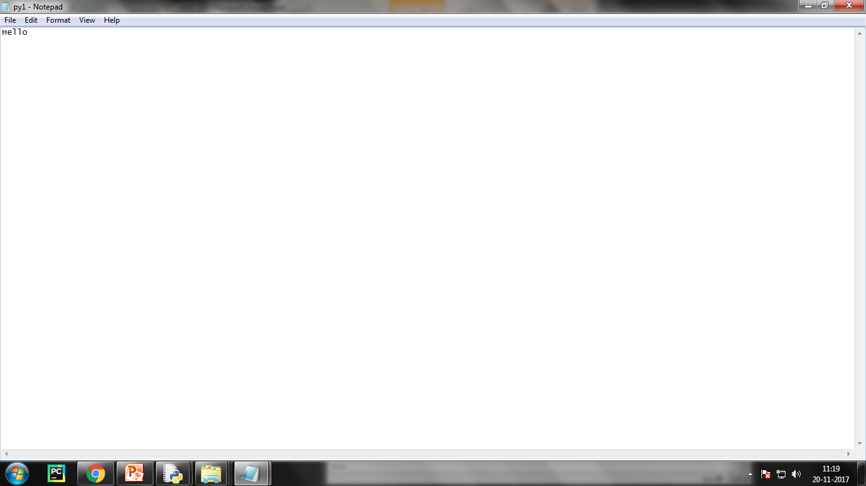
Example for copying the content of one file to another file
f=open("py.txt","r") Snapshot:
p=f.read()
f1=open("py1.txt","w")
f1.write(p)
print("File is copied")
f.close()
f1.close()
Output:
File is copied

Slide 27
Renaming a File
rename() Method:
The rename() method takes two arguments, the current filename and the new filename.
Syntax:
os.rename(current_file_name, new_file_name)
Example:
  import os
  os.rename( “py.txt", “python.txt" )
  print(“File renamed”)
  Output: File renamed

Slide 28
Deleting a File
delete() Method:
You can use the delete() method to delete files by supplying the name of the file to be deleted as the argument. If there is no such filename exists then it returns an error
Syntax:
os.remove(file_name)
Example:
  import os
  os.remove("py1.txt")
  print("File deleted")
  Output:
  File deleted

Slide 29
Directory Methods
Directory is a collection of files where each file may be of different format
Python supports various methods in OS module to work with directories
Uses Methods
To create a new directory mkdir()
To get current working directory getcwd()
To change the current directory chdir()
To remove a directory rmdir()
To remove a nonempty dir rmtree()
To make directories makedirs()

Slide 30
Example 1
import os
import shutil
os.mkdir("New_dir")
print(os.getcwd())
os.chdir("New_dir")
print(os.getcwd())
os.makedirs("subdir1\subdir2\subdir3")
print("Subdirectories created")
os.rmdir("subdir1\subdir2\subdir3")
print("Subdirectory removed")
shutil.rmtree("subdir1")
print("Directory removed")
Output:
C:\Users\english\Desktop
C:\Users\english\Desktop\New_dir
Subdirectories created
Subdirectory removed
Directory removed

Slide 31
Exceptional
Handling

Slide 32
Introduction
Abnormal behavior of the program
Error Logical Errors
Syntactic Errors
Exception Synchronous
Asynchronous

Slide 33
Errors
The programs that we write may behave abnormally or unexpectedly because of some errors and/or exceptions
The two common types of errors that we very often encounter are syntax errors and logic errors.
Syntax errors arises due to poor understanding of the language.
Logic errors occur due to poor understanding of problem and its solution
Logic error specifies all those type of errors in which the program executes but gives incorrect results.

Slide 34
Exception
In some cases, logic errors may lead to divide by zero or accessing an item in a list where the index of the item is outside the bounds of the list.
In this case, the logic error leads to a run-time error that causes the program to terminate abruptly. These types of run-time errors are known as exceptions.

Slide 35
Exception
Errors that occur at run-time (or during execution) are known as exceptions.
An exception is an event, which occurs during the execution of a program and disrupts the normal flow of the program's instructions.
When a program raises an exception, it must handle the exception or the program will be immediately terminated
Exceptions are run-time anomalies or unusual conditions (such as divide by zero, accessing arrays out of its bounds, running out of memory or disk space, overflow, and underflow) that a program may encounter during execution.

Slide 36
Types of Exceptions
Like errors, exceptions can also be categorized as synchronous and asynchronous exceptions.
Synchronous exceptions (like divide by zero, array index out of bound, etc.) can be controlled by the program
Asynchronous exceptions (like an interrupt from the keyboard, hardware malfunction, or disk failure), on the other hand, are caused by events that are beyond the control of the program.

Slide 37
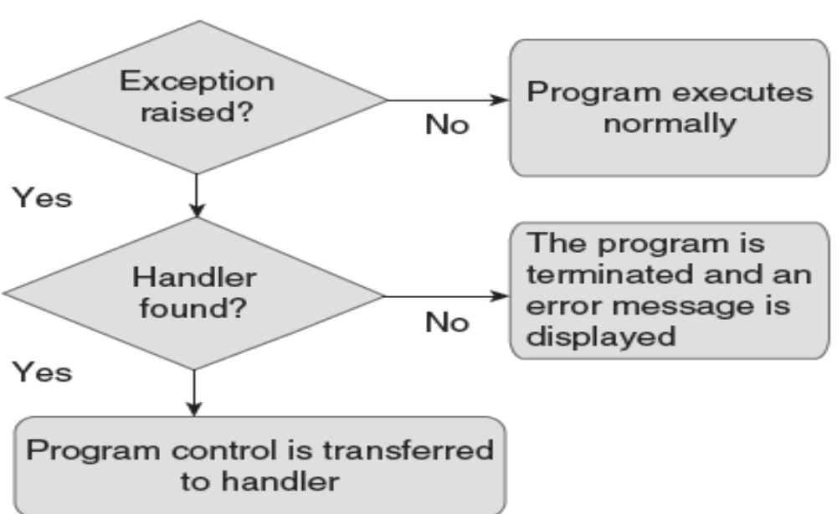
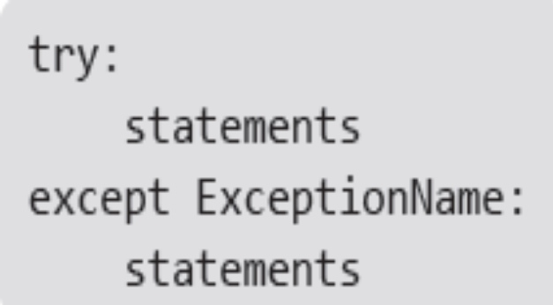
Handling Exceptions
We can handle exceptions in our program by using try block and except block.
A critical operation which can raise exception is placed inside the try block and the code that handles exception is written in except block.
The syntax for try–except block can be given as,

Slide 38
Example:
n=int(input("Enter the numerator : "))
d=int(input("Enter the denominator : "))
try:
q=n/d
print("Quotient : ",q)
except ZeroDivisionError:
print("Denominator cannot be zero")
Output:
Enter the numerator : 45
Enter the denominator : 0
Denominator cannot be zero

Slide 39
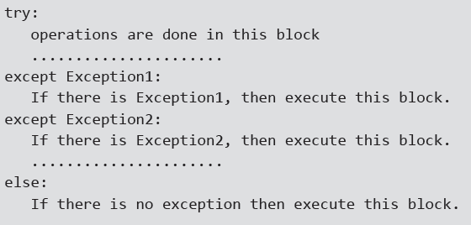
Multiple Except Blocks
Python allows you to have multiple except blocks for a single try block. The block which matches with the exception generated will get executed.
A try block can be associated with more than one except block to specify handlers for different exceptions
However, only one handler will be executed.
The syntax for specifying multiple except blocks for a single try block can be given as,

Slide 40
Example:
try:
n=int(input("Enter the number : "))
res=n**2
print("Result : ",res)
except KeyboardInterrupt:
print("Program Terminated")
except ValueError:
print("Please enter an integer value")
Output:
Enter the number : fhgfh
Please enter an integer value

Slide 41
Example:
try:
n=int(input("Enter the number : "))
res=n**2
print("Result : ",res)
except (KeyboardInterrupt, ValueError, TypeError):
print(“Error Occured")
Output:
Enter the number : fhgfh
Error Occured

Slide 42
except: Block without Exception
You can even specify an except block without mentioning any exception (i.e., except:).
This type of except block if present should be the last one that can serve as a wildcard (when multiple except blocks are present).
But use it with extreme caution, since it may mask a real programming error.
The programmer may not be able to write a different handler (except block) for every individual type of exception.
In such situations, a better idea is to write a handler that would catch all types of exceptions.

Slide 43
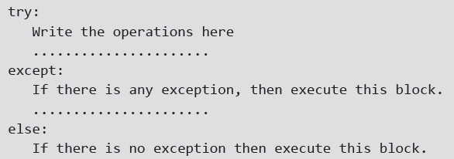
Syntax :

Slide 44
Example:
try:
fp=open("python1.txt","r")
f=fp.read(fp)
print(f)
except KeyboardInterrupt:
print("Keyboard Interrupt")
except ValueError:
print(“Please enter an integer value")
except:
print("File not found")
Output:
Enter the number : fhgfh
Please enter an integer value

Slide 45
The Else Clause
The try ... except block can optionally have an else clause, which, when present, must follow all except blocks. The statement(s) in the else block is executed only if the try clause does not raise an exception.
Example:
Output 1:
try:
n=int(input("Enter an integer : "))
res=n**2
print("Result = ",res)
except KeyboardInterrupt:
print("Keyboard Interrupt")
except:
print("Enter an integer value")
else:
print("Square of a number has been computed")
Enter an integer : 23
Result = 529
Square of a number has been computed
Output 2:
Enter an integer : a
Enter an integer value

Slide 46
The finally Block
The try block has another optional block called finally which is used to define clean-up actions that must be executed under all circumstances.
The finally block is always executed before leaving the try block. This means that the statements written in finally block are executed irrespective of whether an exception has occurred or not.
The syntax of finally block can be given as,
try:
Write your operations here
......................
Due to any exception, operations written here will be skipped
finally:
This would always be executed.
......................

Slide 47
Example :
try:
n=int(input("Enter an integer : "))
res=n**2
print("Result = ",res)
except Keyboard Interrupt:
print("Keyboard Interrupt")
except:
print("Enter an integer value")
finally:
print("Square of a number has been computed")
Output:
Enter an integer : 23
Result = 529
Square of a number has been computed

Slide 48
Raising Exceptions
You can deliberately raise an exception using the raise keyword. The general syntax for the raise statement is, raise [Exception [, args [, traceback]]]
Example :
Output:
try:
n=int(input("Enter an integer : "))
res=n**2
print("Result = ",res)
raise ValueError
except ValueError:
print("Value Error Occured")
except:
print("Enter an integer value")
Enter an integer : g
Value Error Occured

Slide 49
Re-raising Exception
Python allows programmers to re-raise an exception. For example, an exception thrown from the try block can be handled as well as re-raised in the except block using the keyword raise.
The code given below illustrates this concept.
Example :
Output:
try:
n=int(input("Enter an integer : "))
res=n**2
print("Result = ",res)
except:
print("Enter an integer value")
raise
Enter an integer : y
Enter an integer value
Traceback (most recent call last):
File "C:/Users/english/Desktop/exception1.py", line 2, in <module>
n=int(input("Enter an integer : "))
ValueError: invalid literal for int() with base 10: 'y'

Slide 50
Exceptions
Built in Exceptions- Already available in python library
User Defined Exceptions- Python allows user to create their own exception called run time exception. The new exception is derived from base class Exception.

Slide 51
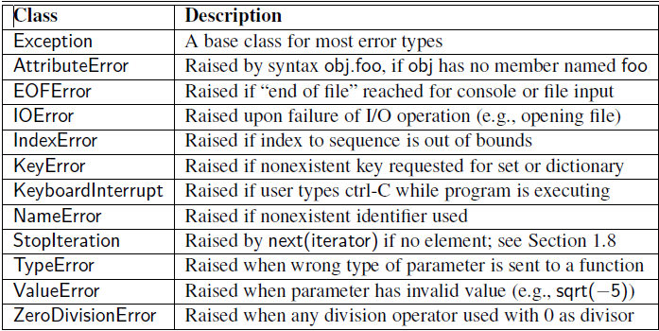
Built In Exceptions

Slide 52
User Defined Exception
Example:
class myerror(Exception):
def __init__(self,val):
self.val=val
try:
val=int(input())
if (val<0):
raise myerror(val)
except myerror as a:
print("User Defined exception generated for negative value",a.val)
else:
print("value is ",val)
OUTPUT:
-45
User Defined exception generated for negative value -45

Slide 53
Predefined Clean up actions
With statement allows the object to be cleaned up or closed after its use
Example:
with open ("aa.txt","r") as f:
print(f.read())
The file is automatically closed after its use.
Where the program below does not close the file after its use
f=open("aa.txt","r")
print(f.read())

Slide 54
Assertion
An assertion is a basic check that can be turned on or off when the program is executed.
Using assert statement, an expression is tested and if the result of the expression is false then it raise the exception.
Syntax:
assert expression, message
Note: Message is optional

Slide 55
Assertions Example
try:
print("enter the number")
a=int(input())
assert(a>=0),"Its Negative"
print("The value is", a)
except AssertionError:
print("Assertion error")
OUTPUT 1:
enter the number
23
The value is 23
OUTPUT 2:
enter the number
-45
Assertion error

Slide 56
Command Line Arguments
The Python sys module provides access to any command-line arguments via the sys.argv.
sys.argv is the list of command-line arguments.
It can be accessed as sys.argv[0], sys.argv[1], sys.argv[2], etc..
By default sys.argv[0] is the Absolute path of file that we are currently running.

Slide 57
How to Run
Check whether Python is properly installed.
Type python.exe filename.py arguments
Python.exe- it is mandatory to execute any python program in command prompt
Filename.py- it is name of your python file
Arguments- it is the command line arguments that we are going to pass as input for user defined file

Slide 58
Example 1
import sys this is first argument(i.e your print(sys.argv[0]) python file name)
OUTPUT File name
C:\>python.exe D:/f1.py
D:/f1.py

Slide 59
Example 2
import sys
c=sys.argv[1]+sys.argv[2]
print("Answer is ",c)
OUTPUT
C:\>python.exe D:/f1.py 3 5
Answer is 8

Slide 60
Example 3
To count the number of words in a text file
import sys
f=open(sys.argv[1], " r ")
l=f.read()
words=l.split()
print(" The Number of words in file ",sys.argv[1], " is ",len(words))
f.close()
OUTPUT:
C:\> python.exe command.py f1.txt
The Number of words in file f1.txt is 12

Slide 61
Example 4
To print the arguments and length of arguments
import sys
print("Arguments is",sys.argv)
print("Length is",len(sys.argv))
OUTPUT:
C:\>python.exe D:/f1.py
Arguments is ['D:/f1.py']
Length is 1
C:\>python.exe D:/f1.py 23 546 34
Arguments is ['D:/f1.py', '23', '546', '34']
Length is 4

Slide 62
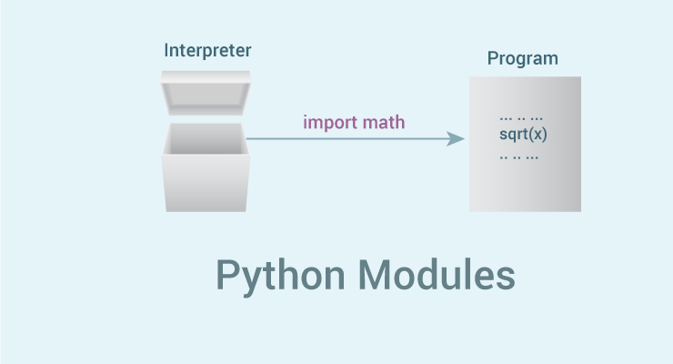
Modules In Python

Slide 63
Modules In Python
Modules are files with .py extension that has definitions of all functions and variables that you would like to use even in other programs, even those functions are not defined in that program.
A module’s definitions can be imported by using “import module_name”
We can import a module using import statement and access the definitions inside it using the dot operator
To access a module’s functions, type “module_name.function()”
Example:
import math
print(math.sqrt(25))
Output:
5

Slide 64
The from…import Statement
When you import a module, you can use any variable or function defined in that module.
But if you want to use only selected variables or functions, then you can use the from...import statement.
Importing One variable
Importing More than One variable/function
from math import pi
print(pi)
Output:
3.141592653589793
from math import pi, sqrt
print(pi)
print(sqrt(pi))
Output:
3.141592653589793
1.7724538509055159

Slide 65
Naming the module
Every module has a name
You can find the name of module using __name__
By default all module has the common name main
Example:
print(__name__)
Output:
main.py

Slide 66
Making your own Modules
Every Python program is a module, that is, every file that you save as .py extension is a module.
You can import the module in any python file
Create a new module and store as mod.py
def display():
print("name of the imported module is ",__name__)
print("We are accessing the function")
msg="Thank You"
Create a new python file(new.py) and run it
import mod
mod.display()
print(mod.msg)
OUTPUT
name of the imported module is mod
We are accessing the function
Thank You

Slide 67
The dir() function
dir() is a built-in function that lists the variables, functions and classes defined in a module.
If no name is specified, the dir() will return the list of names defined in the current module.
File name: new.py
import mod
print(dir(mod))
OUTPUT:
['__builtins__', '__cached__', '__doc__', '__file__', '__loader__', '__name__', '__package__', '__spec__', 'display', 'msg']
File name: new.py
print(dir())
OUTPUT:
['__annotations__', '__builtins__', '__doc__', '__file__', '__loader__', '__name__', '__package__', '__spec__']

Slide 68
Modules and Namespaces
A namespace is a container that provides a named context for identifiers.
Two identifiers with the same name in the same scope will lead to a name clash.
In simple terms, Python does not allow programmers to have two different identifiers with the same name.
However, in some situations we need to have same name identifiers. To cater to such situations, namespaces is the keyword.
Namespaces enable programs to avoid potential name clashes by associating each identifier with the namespace from which it originates.

Slide 69
Example: Without name space Example: With name space
mod.py mod.py
def calculate(x): def calculate(x):
return x*x return x*x
mod1.py mod1.py
def calculate(x): def calculate(x):
return x*x*x return x*x*x
new.py new.py
import mod import mod
import mod1 import mod1
print(calculate(5)) print(mod.calculate(5))
print(mod1.calculate(5))
Output: Output:
NameError: name 'calculate‘ 25
is not defined 125

Slide 70
Global, Local and Built-in Namespaces
Variables or functions present in currently executing program are known as Global Namespace
Variables defined with in functions is called Local Name space
Built-in Function and variables defined in Library files are called Built-in Namespaces.

Slide 71
Example Program
import math
def area(r): Built-in Namespace
res=math.pi*r*r Local Namespace
print("Area of Circle is ",res)
print("Enter radius of Circle")
r=int(input())
area(r) #area, r Global namespace

Slide 72
Private Variables
By default all variables/functions defined in modules are public.
In order to make a particular variable/function as private use double underscore(__) before variable/function.
Now, these private variable/function can not be accessed outside the program even we import the module.

Slide 73
Example Program
File Name: mod.py
def display():
print("We are accessing the function")
def __display1():
print ("We are accessing the private function")
__msg="Thank You"
File Name: mod.py
from mod import *
display()
display1()
print(__msg)
Output:
We are accessing the function
NameError: name '__display1' is not defined
NameError: name '__msg' is not defined

Slide 74
Types of Modules
Python supports three types of modules
  Pre-installed Module- also called as standard library module Eg: os,math,etc..
  Modules imported from External Sources Eg: Plotly - used to plot graph.
  User defined Modules
  Eg: circle,area which is defined by user based on their needs.

Slide 75
Reloading Modules
  When a module is imported in a program the code in the module is executed only once. If you want to re-execute the top level code in a module the use the reload() function.
  Syntax: reload(modulename)
  Egg: reload(circle) #where circle is the module name

Slide 76
Packages
A Package is a hierarchical file directory structure that has modules and other packages with in it.
__init__.py is the special and mandatory file which should be present in every package
__init__.py is used to indicate that the directory is a python package . __init__.py does not have any single line of code
Packages can be imported and used as like that of modules.

Slide 77
Importing from a Package
Package and Main python file should be in same location
You can import the packages in any of the following three ways
import packagename.modulname # imports particular module
from packagename import modulename from package
from packagename import * # imports all modules of a package
If there is no such package then ImportError exception is generated

Slide 78
Example Program
File name: circle.py
import math
def area(r):
return math.pi*r*r
def cir(r):
return 2*math.pi*r
File name: square.py
def area_s(a):
return a*a
def cir_s(a):
return 4*a
File name: __init__.py

Slide 79
Example Program contd…
Filename: new.py
import pack1.circle
import pack1.square
r=int(input ("enter radius for circle"))
print("area of circle=",pack1.circle.area(r))
print("circumference of circle=",pack1.circle.cir(r))
a=int(input("enter side of square"))
print("area of circle=",pack1.square.area_s(a))
print("circumference of circle=",pack1.square.cir_s(a))
OUTPUT:
enter radius for circle 4
area of circle= 50.26548245743669
circumference of circle= 25.132741228718345
enter side of square 6
area of circle= 36
circumference of circle= 24

Slide 80
Function Redefinition
def show():
print("First Function Definition of show")
def show():
print("Second Function Definition of show")
show()
OUTPUT:
Second Function Definition of show

Slide 81
Word Count
import sys
f=open(sys.argv[1],"r")
l=f.read()
words=l.split()
print("The Number of words in file",sys.argv[1],"is",len(words))
f.close()
OUTPUT:
C:\Program Files\Python36-32>python.exe command.py f1.txt
The Number of words in file f1.txt is 12

