Slide 1
COMPUTER
Computer comes from the word “compute”
Compute means to calculate
Definition
Computer is an electronic machine that accepts data and instructions from the user, process the data by performing calculations and operations on it and generates the desired output

Slide 2
ORGANIZATION / PARTS OF COMPUTER
MEMORY UNIT
CPU
INPUT UNIT
OUTPUT UNIT
REGISTERS
CU
ALU

Slide 3
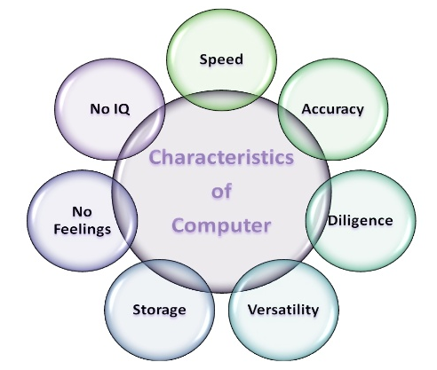
CHARACTERISTICS OF COMPUTER

Slide 4
APPLICATIONS OF COMPUTER
Business
Military
Entertainment
Education
Medical
Space / Research
Banking

Slide 5
UNIT I
ALGORITHMIC PROBLEM SOLVING

Slide 6
PROGRAM?
A set of instruction that instructs the computer about how to perform the task
Before writing Program you should go under particular steps called Software Development Life Cycle (SDLC)

Slide 7
PHASES OF SDLC
1. REQUIREMENT ANALYSIS
2. DESIGN
3. IMPLEMENTATION
4. TESTING
5. SOFTWARE DEPLOYMENT, TRAINING AND SUPPORT
6. MAINTENANCE

Slide 8
DESIGN TOOLS
The tools used in design phase of SDLC are
    Algorithms
    Flowcharts
    Pseudocode

Slide 9
ALGORITHM
Step by step procedure for solving a task.
Algorithm is an ordered sequence of finite, well defined, unambiguous instructions.
For one problem there may be many algorithms.
Programmers selects the best suited algorithm for the given task to be solved.
Algorithms are transformed to flowchart and pseudocode for better understanding.

Slide 10
FLOWCHART
Diagrammatic representation of the logic for solving a task.
Drawn using boxes of different shapes with lines connecting them to show control flow.

Slide 11

FLOWCHART SYMBOLS
Symbol
Description
Start and Stop
Process
Input and Output
Decision Making
Control Flow
Connector
For Loop

Slide 12
PSEUDOCODE
Pseudo means “imitation” and code refers to “instructions” in programming language
Consists of short, readable and formally-styled English language used for explaining an algorithm
Easier for programmer or a non-programmer to understand the general working of the program
Give a sketch of the structure of the program before the actual coding

Slide 13
Example Problem
Print a given number
  Algorithm
STEP 1: Start
STEP 2: Read a number
STEP 3: Print the number
STEP 4: Stop

Slide 14
Example Problem
Print a given number
Flowchart
Start
Read number
Print the number
Stop

Slide 15
Example Problem
Print a given number
    Pseudocode
  START
  READ the number num
  PRINT num
  STOP

Slide 16
CONTROL FLOW
Control flow specify the order of execution of statements
Types:
  Sequential – Instructions are executed in linear order
  Selection – Asks a true / false question and then selects the next instruction based on the answer
  Iterative – repeats the execution of a block of instructions

Slide 17
ALGORITHM TO FIND SUM OF TWO NUMBERS (Sequential)
STEP 1: Start
STEP 2: Read the two numbers A,B
STEP 3: Add two numbers a and b and store the result in C
STEP 4: Print the result C
STEP 5: Stop

Slide 18
TO FIND GREATEST OF THREE NUMBERS (Selection)
ALGORITHM 1
STEP 1: Start
STEP 2: Read the three numbers A,B,C
STEP 3: Compare A and B. If A is greater than or equal to B perform step 4 else perform step 5
STEP 4: Compare A and C. If A is greater than or equal to C print “A is greatest” else print “C is greatest” goto step 6
STEP 5: Compare B and C. If B is greater than or equal to C output “B is greatest” else output “C is greatest”
STEP 6: Stop

Slide 19
TO FIND GREATEST OF THREE NUMBERS (Selection)
ALGORITHM 2
STEP 1: Start
STEP 2: Read the three numbers A,B,C
STEP 3: Compare A and B. If A is greater, store A in MAX, else store B in MAX
STEP 4: Compare MAX and C. If MAX is greater output “MAX is greatest” else output “C is greatest”
STEP 5: Stop
Note:
Programmer selects the algorithm based on the advantages and disadvantages of each algorithm. For example, first algorithm has more number of comparisons but second has additional variable MAX

Slide 20
RECURSION Vs ITERATION
Recursion – A Function which calls itself again and again.
Iteration – A Set of statements is executed N number of times.

Slide 21
FACTORIAL OF A NUMBER
Number Evaluation Result
1! 1 1
2! 2*1 2
3! 3*2*1 6
4! 4*3*2*1 24
5! 5*4*3*2*1 120
etc…

Slide 22
ALGORITHM TO FIND FACTORIAL OF A NUMBER (Iteration)
Step 1: Start
Step 2: Read a positive number N
Step 3: Set variable result to 1 and i to 1
Step 4: If i is less than or equal to N then continue else goto step 8
Step 5: Set result to result *i
Step 6: increment i
Step 7: Goto Step 4
Step 8: Print the result
Step 9: Stop

Slide 23

RECURSION- Real time example
UNIVERSITY EXAM
A student should write the exam till he gets pass in the exam.
Here writing exam is a function.
Function is called itself till he gets 50 mark or above in particular subject.

Slide 24
FACTORIAL (Recursion)
1, if n==0 or n==1
Factorial(n) = n*factorial(n-1), if n>1
Execution
Factorial(4)= 4*factorial(3)
3*factorial(2)
2*factorial(1)
1
Result
factorial(4)= 4*6
3*2
2*1
1
Final result = 24

Slide 25
ALGORITHM TO FIND FACTORIAL OF A NUMBER (Recursion)
Step 1: Start
Step 2: Read the number N
Step 3: Call the function factorial(N)
Step 4: Print the result
Step 5: Stop
factorial(N)
Step 1: If N is equal to 1 then return 1
Step 2: Else Set X to N*factorial(N-1)
Step 3: Return the value of X

Slide 26
ILLUSTRATIVE EXAMPLES

Slide 27
LIST
List is a collection of elements stored under a common name
Ex: a=10 (a is Normal integer variable)
whereas,
b[]={1,2,3,4,5} (b is an integer list)
c[]={34.7,67.3,89.7} (c is a float list)
a
10
b[0] | b[1] | b[2] | b[3] | b[4]
1 | 2 | 3 | 4 | 5

Slide 28
TO FIND MINIMUM IN A LIST - ALGORITHM
Step 1: Start
Step 2: Read the size of list N
Step 3: Read the elements of list a[i] where i value is from 0 to N-1
Step 4: Set min to value of a[0]
Step 5: Initialize j to 1
Step 6: If j is less than N then continue else goto step 9
Step 7: If min is greater than a[j] then Set min to a[j] else goto step 8
Step 8: Increment j and goto step 6
Step 9: Print the result min
Step 10: Stop

Slide 29
FLOWCHART
A
Start
While j<N
False
Read size of list N
True
i=0
If min > a[j]
False
while i<N
False
True
True
Min=a[j]
Read a[i]
j++
i++
Print Min
min=a[0]
j = 1
Stop
A

Slide 30
PSEUDOCODE
START
READ N
i=0
While(i<N)
Read a[i]
End While
ASSIGN min=a[0]
ASSIGN j=1
While(j<N)
COMPARE if(min>a[j])
ASSIGN min=a[j]
End if
Increment j
End While
PRINT min
STOP

Slide 31
INSERT A CARD IN A LIST OF SORTED CARDS- ALGORITHM
Step 1: Start
Step 2: Let us assume size of list is N
Step 3: Read the card number to insert X
Step 4: Initialize i to 0
Step 5: if i is less than N goto step 6 else goto step 10
Step 6: If X is greater than a[i] then increment i and goto step 6 else goto step 7
Step 7: Assign k=N-1
Step 8 : If k is greater than or equal to i then assign a[k] to a[k+1] else goto step 10
Step 9: Decrement k and goto step 8
Step 10: Assign X to a[k+1]
Step 11: Stop

Slide 32
FLOWCHART
B
Start
While k>=i
False
Assume size of list is N
Read the card to insert X
True
a[k+1]=a[k]
i= 0
k--
If i < N
False
A
A
a[k+1]=X
True
While X>a[i]
Stop
False
True
i++
k=N-1
B

Slide 33
PSEUDOCODE
START
ASSUME array size is N
READ X
Initialize i=0
If i<N
While (X>a[i])
i++
End While
ASSIGN k=N-1
While k>=i
ASSIGN a[k+1]=a[k]
k--
End While
End if
ASSIGN a[k+1]=X
STOP

Slide 34
GUESS AN INTEGER NUMBER IN A RANGE -ALGORITHM
Step 1: Start
Step 2: Read the Range Min and Max form user
Step 3: Generate a random number and store it in X
Step 4: If the value of X is between Min and Max then print value of X else goto step 3
Step 5: Stop

Slide 35
FLOWCHART
Start
Read Min and Max Value
X=rand()
If X>=Min && X<=Max
False
True
Print value of X
Stop

Slide 36
PSEUDOCODE
START
READ Min,Max
label:PROCESS X=rand()
If X>=Min AND X<=Max
PRINT X
Else
Goto label
End if
STOP

Slide 37
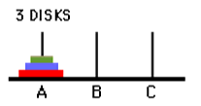
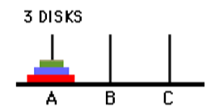
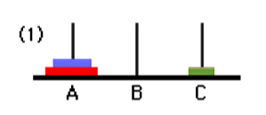
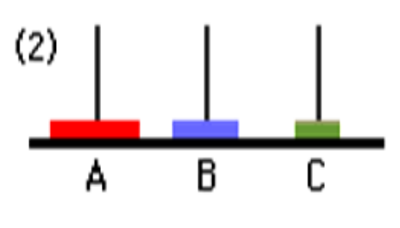
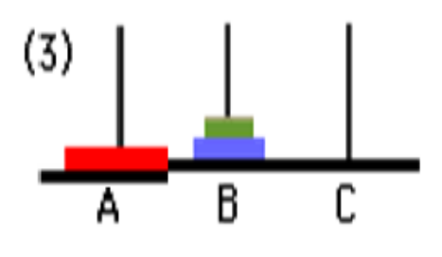
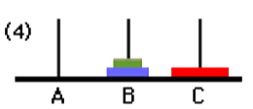
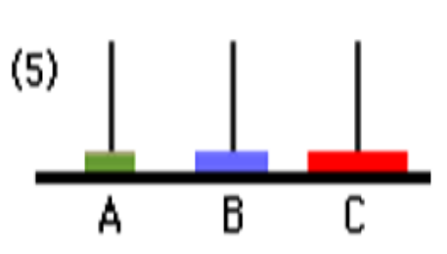
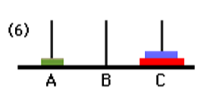
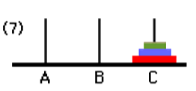
TOWER OF HANOI
Move the N disk from tower A to tower C using the tower B

Slide 38
TOWER OF HANOI- ALGORITHM
Step 1: Start
Step 2: Read the number of disc n
Step 3: Call the function tower(n,A,C,B)
Step 4: Stop
Algorithm for Function Definition
Step 1: if n==1 then Move disc from A to C and goto step 5 else continue
Step 2: Call the function tower(n-1,A,B,C)
Step 3: Move disc n from A to C
Step 4: Call the function tower(n-1,B,C,A)
Step 5: Return

Slide 39
FLOWCHART
Start
Tower(n,A,C,B)
If n==1
Read n
False
Tower(n,A,C,B)
True
Tower(n-1,A,B,C)
Move Disc from A to C
Stop
Move N th Disc from A to C
Tower(n-1,B,C,A)
Return

Slide 40
PSEUDOCODE
START
READ n
CALL tower(n,A,C,B)
STOP
Function Defention
if n==1
Move disc from A to C
return
End if
CALL tower(n-1,A,B,C)
Move disc n from A to C
CALL tower(n-1,B,C,A)
Return

