Slide 1
UNIT III
FILE SYSTEM
Dr. V.Kumar
Professor and Head
Department of Computer Science and Engineering
Knowledge Institute of Technology

Slide 2
The Virtual File system
Transparently mount disks or partitions that host file formats used by Windows, other Unix systems.
The Virtual File system is to put a wide range of information in the kernel to represent many different types of file systems.
Read, write, or other function called, the kernel substitutes.
Five standard Unix file types—namely, regular files, directories, and symbolic links.

Slide 3
The Role of the Virtual File system (VFS)
It is a kernel software layer that handles all system calls related to a standard Unix file system.
Shell command:
$ cp /floppy/TEST /tmp/test
VFS by means of generic system calls known to anyone who has done Unix programming

Slide 4
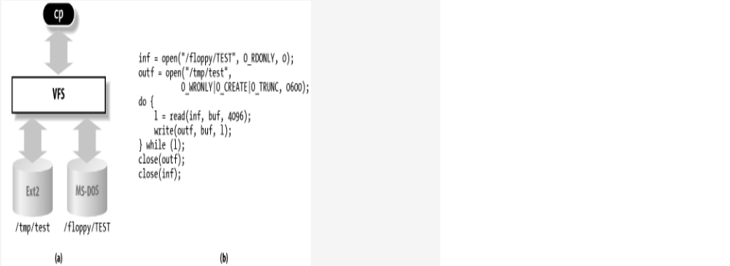
VFS role in a simple file copy operation

Slide 5
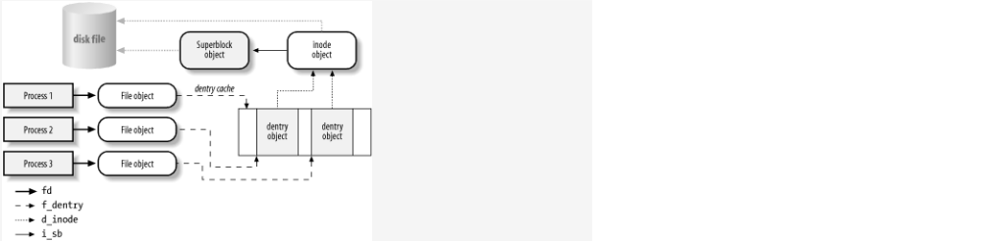
Interaction between processes and VFS objects

Slide 6
System Calls Handled by the VFS
System call name | Description
mount( ) umount( ) | Mount/unmount filesystems
sysfs( ) | Get filesystem information

Slide 7
Superblock Objects
Type | Field | Description
struct list_head | s_list | Pointers for superblock list
kdev_t | s_dev | Device identifier
unsigned long | s_blocksize | Block size in bytes
unsigned char | s_blocksize_bits | Block size in number of bits
unsigned char | s_dirt | Modified (dirty) flag
unsigned long long | s_maxbytes | Maximum size of the files
struct file_system_type * | s_type | Filesystem type
struct super_operations * | s_op | Superblock methods
struct dquot_operations * | dq_op | Disk quota methods

Slide 8
Dentry Objects
The kernel creates a dentry object for every component of a pathname that a process looks up.
The dentry object associates the component to its corresponding inode.
dentry objects have no corresponding image on disk.
Dentry objects are stored in a slab allocator cache called dentry_cache
Dentry objects are thus created and destroyed by invoking kmem_cache_alloc( ) and kmem_cache_free( ).

Slide 9
The fields of the dentry object
Type | Field | Description
atomic_t | d_count | Dentry object usage counter
unsigned int | d_flags | Dentry flags
struct inode * | d_inode | Inode associated with filename
struct dentry * | d_parent | Dentry object of parent directory
struct list_head | d_hash | Pointers for list in hash table entry
struct list_head | d_lru | Pointers for unused list

Slide 10
Dentry object –Four States
Free
The corresponding memory area is handled by the slab allocator.
Unused
The d_count usage counter of the object is 0, but the d_inode field still points to the associated inode.
In use
The d_count usage counter is positive and thed_inode field points to the associated inode object.
Negative
The d_inode field of the dentry object is set to NULL, but the object still remains in the dentry cache so that further lookup operations to the same file pathname can be quickly resolved.

Slide 11
Files Associated with a Process
Type | Field | Description
atomic_t | count | Number of processes sharing this table
rwlock_t | lock | Read/write spin lock for the table fields
int | umask | Bit mask used when opening the file to set the file permissions
struct dentry * | root | Dentry of the root directory
struct dentry * | pwd | Dentry of the current working directory
struct dentry * | altroot | Dentry of the emulated root directory (always NULL for the 80 × 86 architecture)
struct vfsmount * | rootmnt | Mounted filesystem object of the root directory
struct vfsmount * | pwdmnt | Mounted filesystem object of the current working directory
struct vfsmount * | altrootmnt | Mounted filesystem object of the emulated root directory (always NULL for the 80 × 86 architecture)

Slide 12
files_struct structure
Type | Field | Description
int | max_fdset | Current maximum number of file descriptors
int | next_fd | Maximum file descriptors ever allocated plus 1
struct file ** | fd | Pointer to array of file object pointers
fd_set * | close_on_exec | Pointer to file descriptors to be closed on exec( )
fd_set * | open_fds | Pointer to open file descriptors
fd_set | close_on_exec_init | Initial set of file descriptors to be closed on exec( )
fd_set | open_fds_init | Initial set of file descriptors
struct file ** | fd_array | Initial array of file object pointers

Slide 13
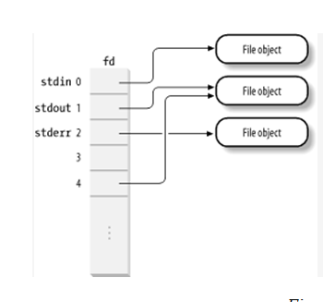
The fd array

Slide 14
File system Type Registration
Type | Field | Description
const char * | name | Filesystem name
int | fs_flags | Filesystem type flags
struct super_block *(*)( ) | read_super | Method for reading superblock
struct module * | owner | Pointer to the module implementing the filesystem (see Appendix B)
struct file_system_type * | next | Pointer to the next list element
struct list_head | fs_supers | Head of a list of superblock objects

Slide 15
File system Mounting
The file system whose root directory is the root of the system’s directory tree is called root file system .
mount -t ext2 /dev/fd0 /flp
mount -t ext2 -o ro /dev/fd0 /flp-ro
Each new mount on the same mount point hides the previously mounted file system

Slide 16
vfsmount data structure
Type | Field | Description
struct list_head | mnt_hash | Pointers for the hash table list
struct vfsmount * | mnt_parent | Points to the parent filesystem on which this filesystem is mounted on
struct dentry * | mnt_mountpoint | Points to the dentry of the mount directory of this filesystem
struct dentry * | mnt_root | Points to the dentry of the root directory of this filesystem

Slide 17
Mounted file system flags
Name | Description
MNT_NOSUID | Forbid setuid and setgid flags in the mounted filesystem
MNT_NODEV | Forbid access to device files in the mounted filesystem
MNT_NOEXEC | Disallow program execution in the mounted filesystem

Slide 18
Mounting the Root File system
Mounting the root file system is a two-stage procedure
The kernel mounts the special rootfs file system, which just provides an empty directory that serves as initial mount point.
The kernel mounts the real root file system over the empty directory.

Slide 19
Mounting the Root File system
struct file_system_type root_fs_type; root_fs_type.name = "rootfs"; root_fs_type.read_super = rootfs_read_super; root_fs_type.fs_flags = FS_NOMOUNT; register_filesystem(&root_fs_type);
root_vfsmnt = do_kern_mount("rootfs", 0, "rootfs", NULL);

Slide 20
Mounting a Generic File system
The pathname of a device file containing the file system, or NULL if it is not required
The pathname of the directory on which the file system will be mounted
The file system type, which must be the name of a registered file system
The mount flags
A pointer to a file system-dependent data structure

Slide 21
Unmounting a File system
Invokes path_init( ) and path_walk( )
Retrieves the address of the superblock object from the mnt_sb field of the mounted filesystem object.
  Acquires the mount_sem semaphore for writing and the dcache_lock dentry spin lock.

Slide 22
Implementations of VFS System Calls
inf = open("/floppy/TEST", O_RDONLY, 0);
outf = open("/tmp/test", O_WRONLY | O_CREAT | O_TRUNC, 0600);
do {
len = read(inf, buf, 4096); write(outf, buf, len);
} while (len);
close(outf);
close(inf);

