Slide 1
Software Requirement Specification Hospital Management System

Slide 2
1.1 - Purpose
• The Software is for the automation of Hospital Management.
• It maintains two levels of users:-
  Administrator Level
  User Level
• The Software includes:-
  Maintaining Patient details.
  Providing Prescription, Precautions and Diet advice.
  Providing and maintaining all kinds of tests for a patient.
  Billing and Report generation.

Slide 3
1.2 - Scope
It can be used in any Hospital, Clinic, Dispensary or Pathology labs for maintaining patient details and their test results.
1.3 - Technologies to be used
This project will be a desktop application to be developed in VB 6.0 having Ms Access as backend.
  • Database Design (Ms Access)
  • Form Design (VB 6.0)
  • Coding (VB 6.0)
  • Testing (VB 6.0)
  • Reporting Tool (Data Report)

Slide 4
1.4 - Overview
Project is related to Hospital Management System.
The project maintains two levels of users:-
  • Administrator Level-Doctor
  • User Level-Data Entry Operator
Main facilities available in this project are:-
  • Maintaining records of indoor/outdoor patients.
  • Maintaining patients diagnosis details, advised tests to be done.
  • Providing different test facilities to a doctor for diagnosis of patients.
    X-Ray
    Urine Test
    Stool Test
    Sonography Test
    Gastroscopy Test
    Colonoscopy Test
    Blood Test
    Biochemistry Test

Slide 5
Maintaining patient’s injection entry records.
Maintaining patient’s prescription, medicine and diet advice details.
Providing billing details for indoor/outdoor patients.
Maintaining backup of data as per user requirements (between mentioned dates).
If user forgets his/her password then it can be retrieved by hint question.
In this project collection of data is from different pathology labs.
Results of tests, prescription, precautions and diet advice will be automatically updated in the database.
Related test reports, patient details report, prescription and billing reports can be generated as per user requirements.
User or Administrator can search a patient’s record by his/her name or their registration date.
Patient’s diet advice can be provided in Hindi.

Slide 6
Overall Description
2.1- Goals of proposed system
1. Planned approach towards working: - The working in the organization will be well planned and organized. The data will be stored properly in data stores, which will help in retrieval of information as well as its storage.
2. Accuracy: - The level of accuracy in the proposed system will be higher. All operation would be done correctly and it ensures that whatever information is coming from the center is accurate.
3. Reliability: - The reliability of the proposed system will be high due to the above stated reasons. The reason for the increased reliability of the system is that now there would be proper storage of information.

Slide 7
Overall Description
2.1- Goals of proposed system
4. No Redundancy: - In the proposed system utmost care would be that no information is repeated anywhere, in storage or otherwise. This would assure economic use of storage space and consistency in the data stored.
5. Immediate retrieval of information: - The main objective of proposed system is to provide for a quick and efficient retrieval of information. Any type of information would be available whenever the user requires.
6. Immediate storage of information: - In manual system there are many problems to store the largest amount of information.
7. Easy to Operate: - The system should be easy to operate and should be such that it can be developed within a short period of time and fit in the limited budget of the user.
.

Slide 8
Overall Description
2.2- Background
A Hospital is a place where Patients come up for general diseases. Hospitals provide facilities like:-
  Consultation by Doctors on Diseases.
  Diagnosis for diseases.
  Providing treatment facility.
  Facility for admitting Patients (providing beds, nursing, medicines etc.)
  Immunization for Patients/Children.
Various operational works that are done in a Hospital are:-
  Recording information about the Patients that come.
  Generating bills.
  Recording information related to diagnosis given to Patients.
  Keeping record of the Immunization provided to children/patients.
  Keeping information about various diseases and medicines available to cure them.

Slide 9
Overall Description
2.2- Background
The work is done as follows:-
Information about Patients is done by just writing the Patients name, age and gender. Whenever the Patient comes up his information is stored freshly.
Bills are generated by recording price for each facility provided to Patient on a separate sheet and at last they all are summed up.
Diagnosis information to patients is generally recorded on the document, which contains Patient information. It is destroyed after some time period to decrease the paper load in the office.
Immunization records of children are maintained in pre-formatted sheets, which are kept in a file.
Information about various diseases is not kept as any document. Doctors themselves do this job by remembering various medicines.

Slide 10
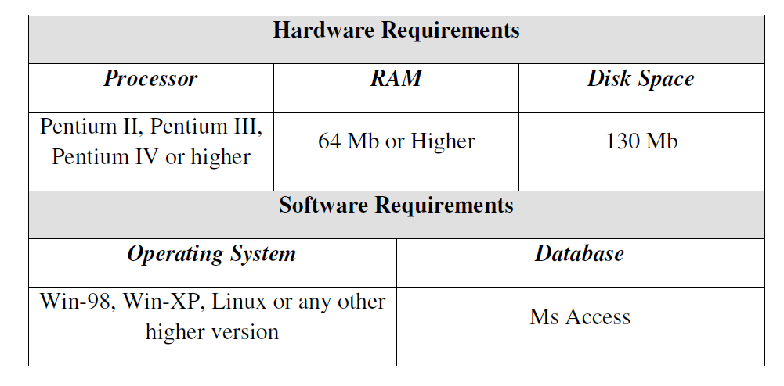
Overall Description
2.3 – Project Requirements

Slide 11
Overall Description
2.4) User Characteristics
Every user should be:
• Comfortable of working with computer.
• He must have knowledge in medical field.
• He must also have basic knowledge of English too.
2.5) Constraints
• GUI is only in English.
• Login and password is used for identification of user and there is no facility for guest.

Slide 12
2.6- Definitions of problems
Problems with conventional system
1. Lack of immediate retrievals: -The information is very difficult to retrieve and to find particular information like- E.g. - To find out about the patient’s history, the user has to go through various registers. This results in inconvenience and wastage of time.
2. Lack of immediate information storage: - The information generated by
various transactions takes time and efforts to be stored at right place.
3. Lack of prompt updating: - Various changes to information like patient
details or immunization details of child are difficult to make as paper work is
involved.
4. Error prone manual calculation: - Manual calculations are error prone and take a lot of time this may result in incorrect information. For example
calculation of patient’s bill based on various treatments.
5. Preparation of accurate and prompt reports: - This becomes a difficult
task as information is difficult to collect from various registers.

Slide 13
2.7 – Alternative System
1. Improved Manual System:-
One of the alternative solutions is the improvement of the manual system.
Anything, which can be done by using automated methods, can be done manually. But the question arises how to perform thing manually in a sound manner. Following are some suggestions, which can be useful in the manual system.
A more sophisticate register maintenance for various Patient Information, Doctor diary, Immunization Details and a good system for writing bill amount employees and stock availed for the customers can be maintained at central place.
Adequate staff may be maintained so that updations are made at the very moment at the same time. Proper person for proper work should be made responsible so that a better efficiency could be achieved. This needs a lot of work force.

Slide 14
2.7 – Alternative System
2. Batch System:-
Another alternative solution can be used of computer based batch system for maintaining the information regarding purchase details, customers and employees. A batch system refers to a system in which data is processed in a periodical basis.
The batch system is able to achieve most of the goals and sub goals. But a batch system data is processed in sequential basis. Therefore batch system is not suggested.
3. Online System:-
This system (HMS) provides online storage/ updations and retrieval facility. This system promises very less or no paper work and also provides help to Doctor and operational staff.
In this system everything is stored electronically so very less amount of paper work is required and information can be retrieved very easily without searching here and there into registers. This system is been discussed here.

Slide 15
3 – Feasibility Analysis
Depending on the results of the initial investigation the survey is now expanded to a more detailed feasibility study. “FEASIBILITY STUDY” is a test of system proposal according to its workability, impact of the organization, ability to meet needs and effective use of the resources

Slide 16
3 – Feasibility Analysis
Eight steps involved in the feasibility analysis are:
Form a project team and appoint a project leader.
Prepare system flowcharts.
Enumerate potential proposed system.
Define and identify characteristics of proposed system.
Determine and evaluate performance and cost effective of each proposed system.
Weight system performance and cost data.
Select the best-proposed system.
Prepare and report final project directive to management.

Slide 17
3.1.- Technical Feasability
A study of resource availability that may affect the ability to achieve an acceptable system. This evaluation determines whether the technology needed for the proposed system is available or not.

Slide 18
Front-end and back-end selection
An important issue for the development of a project is the selection of suitable front-end and back-end. When we decided to develop the project we went through an extensive study to determine the most suitable platform that suits the needs of the organization as well as helps in development of the project.
The aspects of our study included the following factors.

Slide 19
Front-end selection:
1. It must have a graphical user interface that assists employees that are not from IT
background.
2. Scalability and extensibility.
3. Flexibility.
4. Robustness.
5. According to the organization requirement and the culture.
6. Must provide excellent reporting features with good printing support.
7. Platform independent.
8. Easy to debug and maintain.
9. Event driven programming facility.
10. Front end must support some popular back end like Ms Access.
According to the above stated features we selected VB6.0 as the front-end for
developing our project.

Slide 20
Back-end Selection:
1. Multiple user support.
2. Efficient data handling.
3. Provide inherent features for security.
4. Efficient data retrieval and maintenance.
5. Stored procedures.
6. Popularity.
7. Operating System compatible.
8. Easy to install.
9. Various drivers must be available.
10. Easy to implant with the Front-end.
According to above stated features we selected Ms-Access as the backend.

Slide 21
3.2 - Economic Feasibility
Economic justification is generally the “Bottom Line” consideration for most systems.
Economic justification includes a broad range of concerns that includes cost benefit analysis.
In this we weight the cost and the benefits associated with the candidate system and if it suits the basic purpose of the organization i.e. profit making, the project is making to the analysis and design phase.

Slide 22
3.2 - Economic Feasibility
The financial and the economic questions during the preliminary investigation are verified to estimate the following:
The cost to conduct a full system investigation.
The cost of hardware and software for the class of application being considered.
The benefits in the form of reduced cost.
The proposed system will give the minute information, as a result the performance is improved which in turn may be expected to provide increased profits.
This feasibility checks whether the system can be developed with the available funds. The Hospital Management System does not require enormous amount of money to be developed. This can be done economically if planned judicially, so it is economically feasible. The cost of project depends upon the number of man-hours required

Slide 23
3.3 - Operational Feasibility
It is mainly related to human organizations and political aspects. The points to be considered are:
What changes will be brought with the system?
What organization structures are disturbed?
What new skills will be required? Do the existing staff members have these skills? If not, can they be trained in due course of time?
The system is operationally feasible as it very easy for the End users to operate it. It only needs basic information about Windows platform.

Slide 24
3.4 - Schedule feasibility
Time evaluation is the most important consideration in the development of project.
The time schedule required for the developed of this project is very important since more development time effect machine time, cost and cause delay in the development of other systems.
A reliable Hospital Management System can be developed in the considerable amount of time

Slide 25
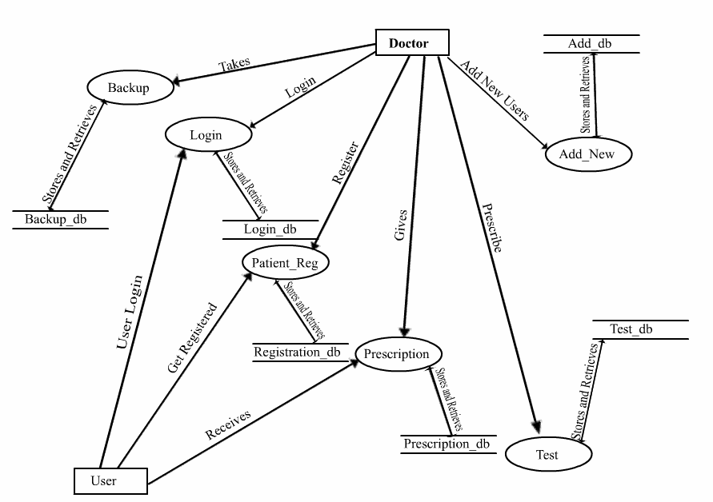
DFD-0

Slide 26
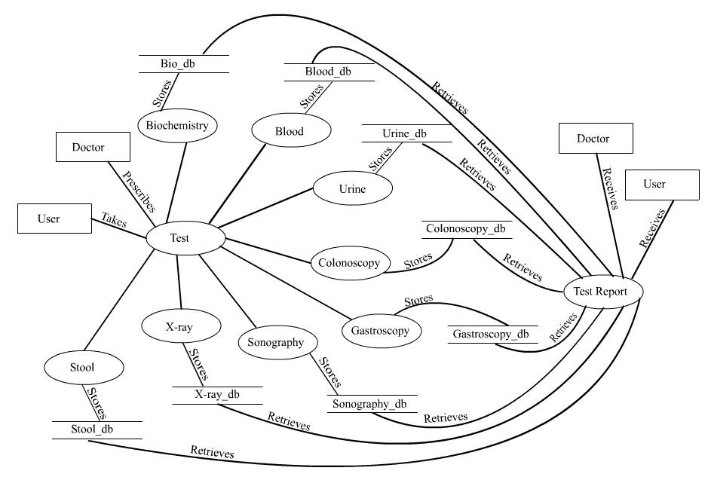
DFD –Level-1

Slide 27
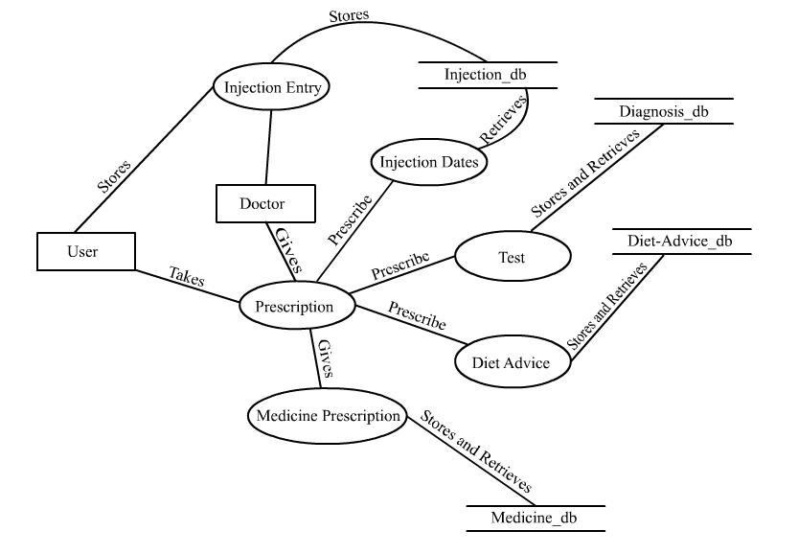
DFD-Level-2

Slide 28
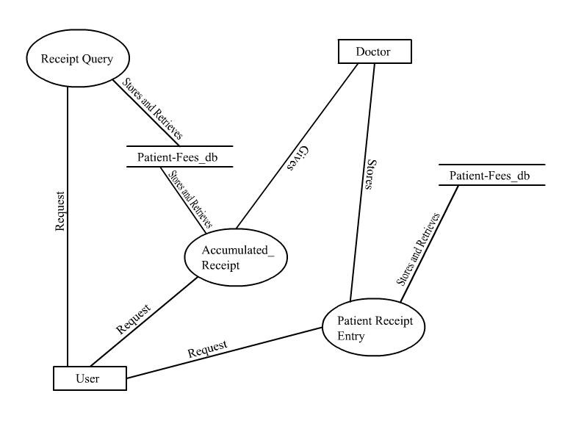
DFD-Level-2
DFD-Level-3

Slide 29
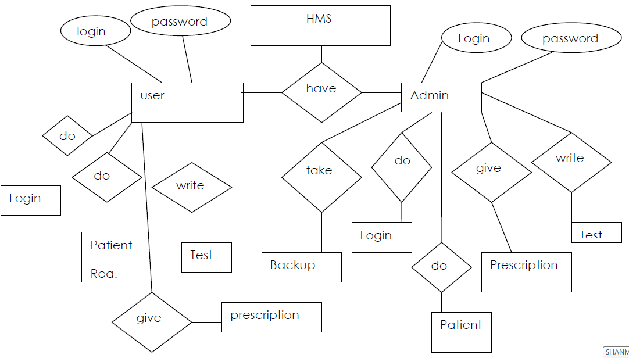
ER-Diagram

Slide 30
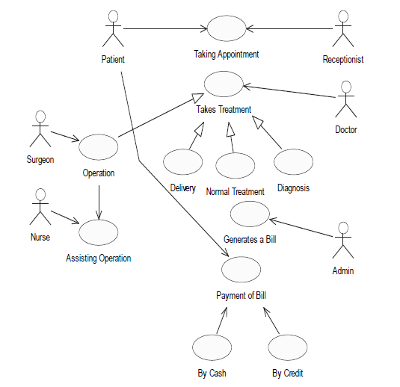
Use –Case Diagram

Slide 31
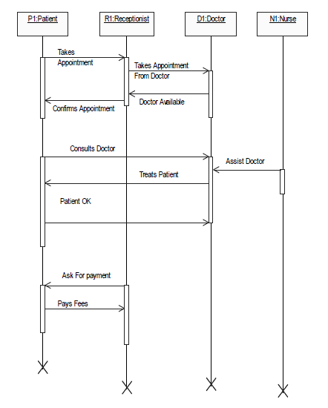
Sequence Diagram

Slide 32
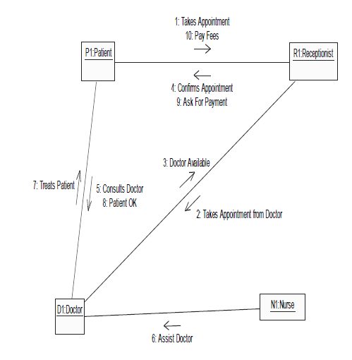
Collabaration Diagram

Slide 33
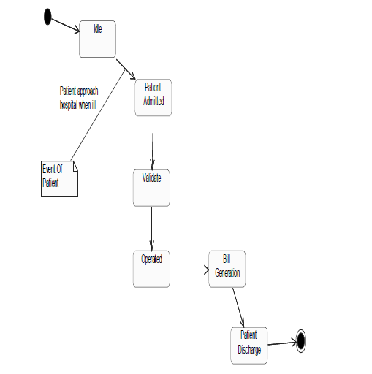
State chart Diagram

Slide 34
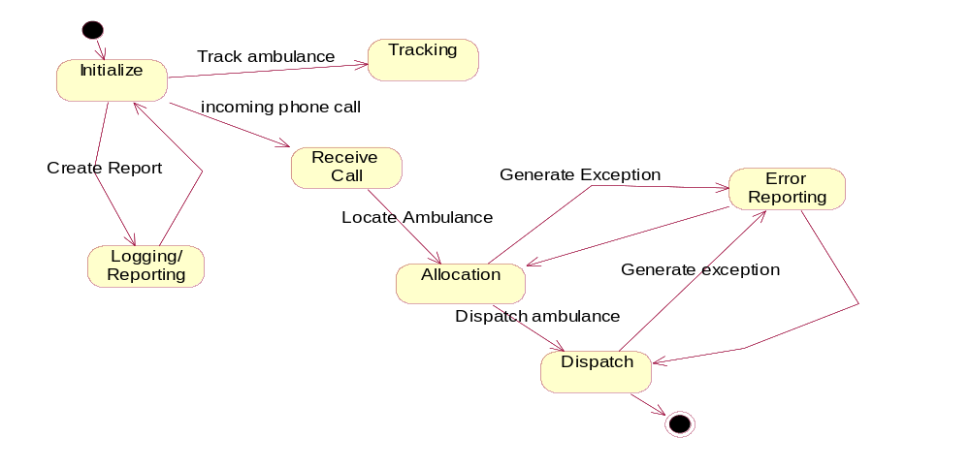
State Chart Diagram

Slide 35
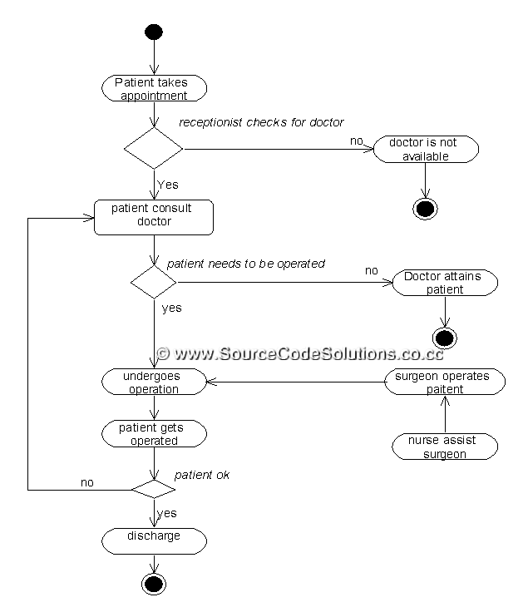
Activity Diagram

Slide 36
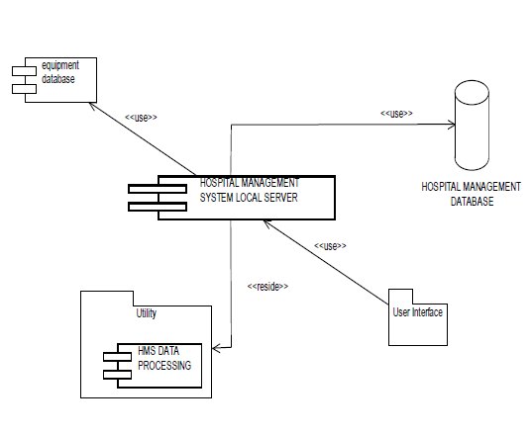
Component Diagram

Slide 37
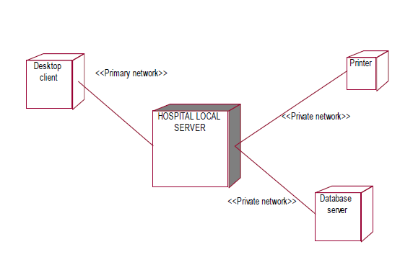
Deployment Diagram

Slide 38
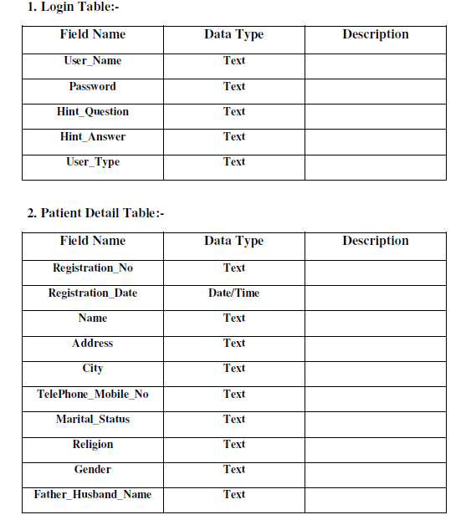
Data Dictionary

Slide 39
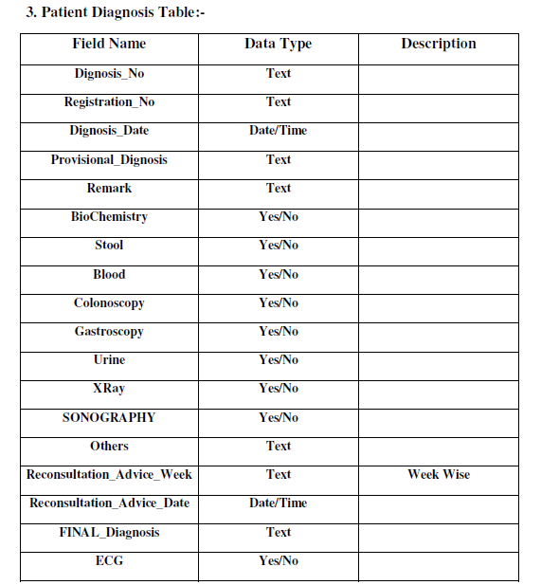

Slide 40
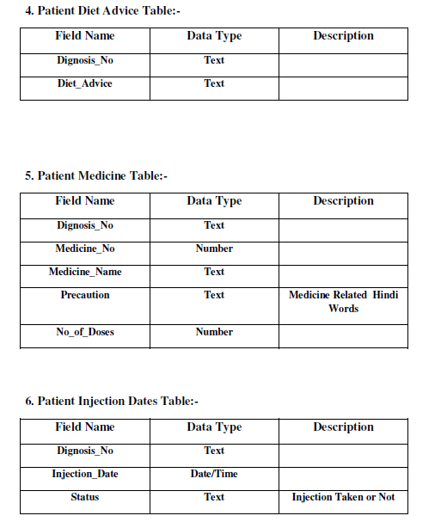

Slide 41
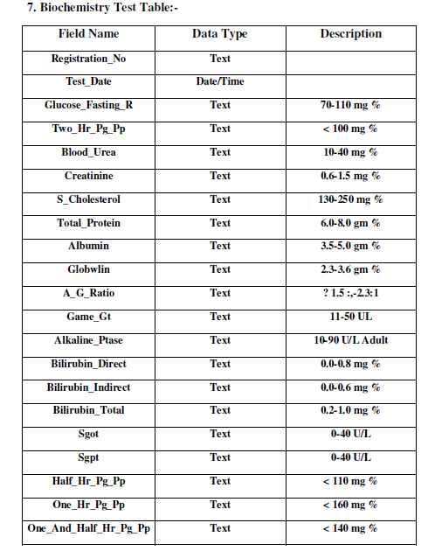

Slide 42
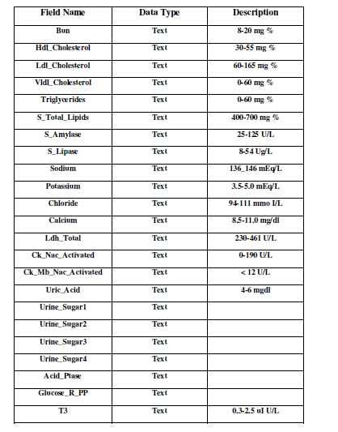

Slide 43
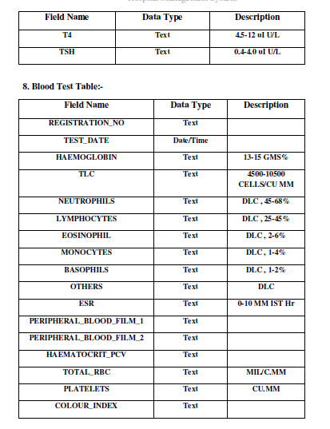

Slide 44
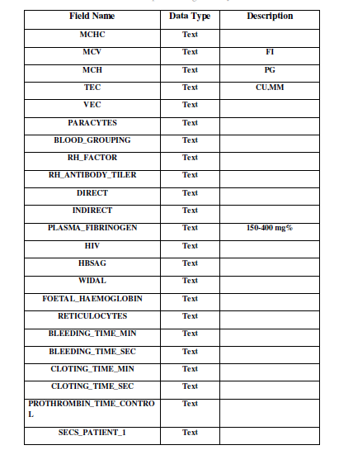

Slide 45
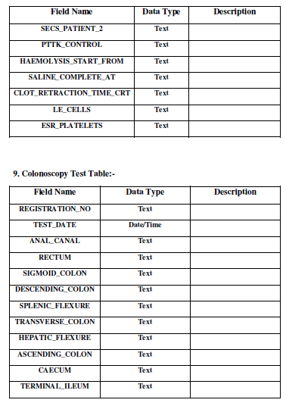

Slide 46
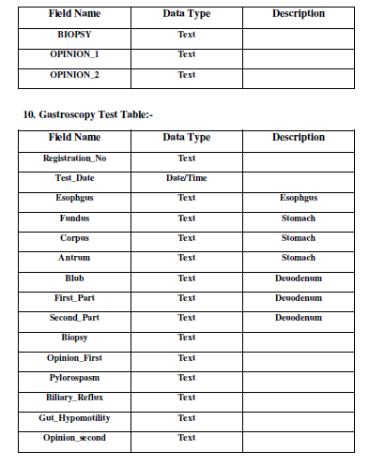

Slide 47
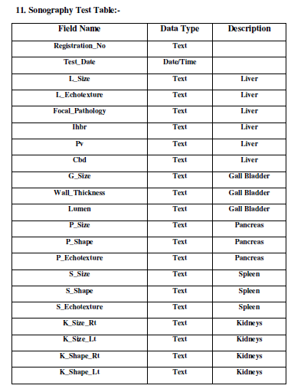

Slide 48
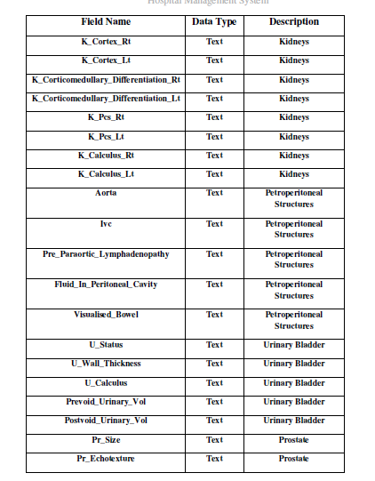

Slide 49
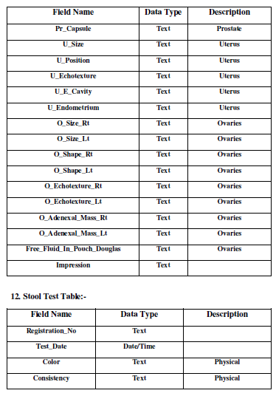

Slide 50
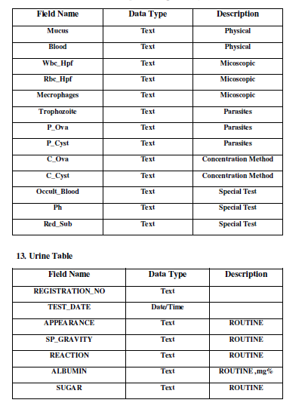

Slide 51
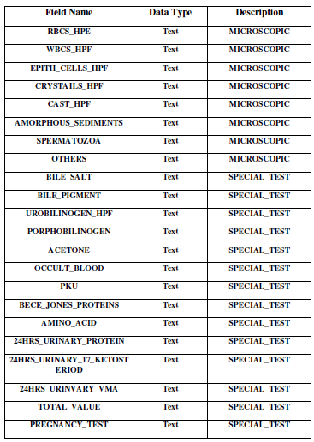

Slide 52
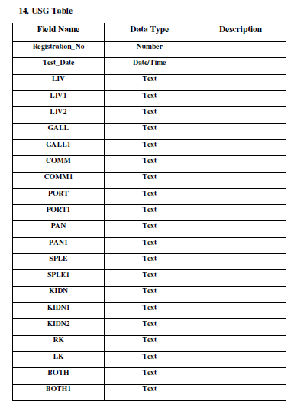

Slide 53
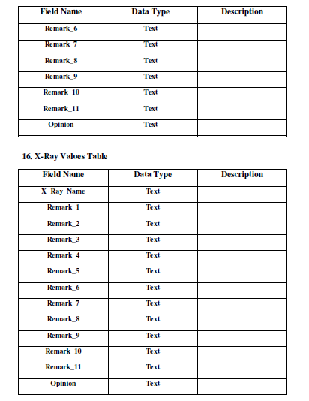

Slide 54
