Slide 1
CS6703-Grid and Cloud Computing
UNIT II-GRID SERVICES
Faculty: Mr. M. Senthil Kumar
AP/CSE
KIOT , Salem

Slide 2
UNIT II GRID SERVICES
Introduction to Open Grid Services Architecture (OGSA) – Motivation – Functionality Requirements – Practical & Detailed view of OGSA/OGSI – Data intensive grid service models – OGSA services.

Slide 3
What is the OGSA Standard?
Acronym for Open Grid Service Architecture
OGSA define how different components in grid interact
Open Grid Services Architecture (OGSA) is a set of standards defining the way in which information is shared among diverse components of large, heterogeneous grid systems. In this context, a grid system is a scalable wide area network (WAN) that supports resource sharing and distribution.

Slide 4
Architecture of OGSA
Comprised of 4 main layers
Physical and Logical Resources Layer
Web Service Layer
OGSA Architected Grid Services Layer
Grid Applications Layer

Slide 5
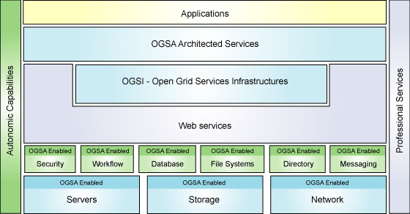
OGSA Architecture

Slide 6
OGSA Architecture - Physical and Logical Resources Layer
Physical resources are: servers, storage, network
Logical resources manage physical resources
Examples of logical resources: database managers, workflow managers

Slide 7
OGSA Architecture - Web Services Layer
Web service is software available online that could interact with other software using XML
Consists of Open Grid Services Infrastructure (OGSI) sub-layer which specifies grid services and provide consistent way to interact with grid services
Also extends Web Service Capabilities
Consists of 5 interfaces:
Factory: provide way for creation of new grid services
Life Cycle: Manages grid service life cycles
State Management: Manage grid service states
Service Groups: collection of indexed grid services
Notification: Manages notification between services & resources

Slide 8
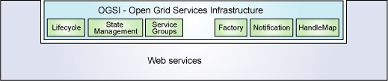
OGSA Architecture - Web Services Layer (OGSI)

Slide 9
OGSA Architecture – OGSA Architected Services - Layer
Classified into 3 service categories
Grid Core Services
Grid Program Execution Services
Grid Data Services

Slide 10
OGSA Architected Services – Grid Core Services
Composed of 4 main types of services:
Service Management: assist in installation, maintenance, & troubleshooting tasks in grid system
Service Communication: include functions that allow grid services to communicate
Policy Services: Provide framework for creation, administration & management of policies for system operation
Security Services: provide authentication & authorization mechanisms to ensure systems interoperate securely

Slide 11
OGSA Architected Services – Grid Program Execution Services
Supports unique grid systems in high performance computing, collaboration, parallelism
Support virtualization of resource processing

Slide 12
OGSA Architected Services – Grid Data Services
Support data virtualization
Provide mechanism for access to distributed resources such as databases, files

Slide 13
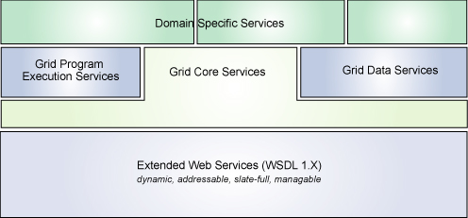
OGSA Architecture – OGSA Architected Services - Layer

Slide 14
OGSA Architecture – Grid Applications Layer
This layer comprise of applications that use the grid architected services

Slide 15
Conclusion
Grid-Computing allows networked resources to be combined and used
Grid-Computing offers great benefit to an organization
OGSA are comprehensive standards which governs grid-computing

Slide 16
Open Grid Services Infrastructure (OGSI)
Gives a formal and technical specification of what a grid service is.
Its a excruciatingly detailed specification of how Grid Services work.
GT3 includes a complete implementation of OGSI.
It is a formal and technical specification of the concepts described in OGSA.
The Globus Toolkit 3 is an implementation of OGSI.
Some other implementations are OGSI::Lite (Perl)1 and the UNICORE OGSA demonstrator2 from the EU GRIP project.
OGSI specification defines grid services and builds upon web services.

Slide 17
Open Grid Services Infrastructure (OGSI)
OGSI creates an extension model for WSDL called GWSDL (Grid WSDL). The reason is:
  Interface inheritance
  Service Data (for expressing state information)
Components:
  Lifecycle
  State management
  Service Groups
  Factory
  Notification
  Handle Map

Slide 18
Data intensive grid service models
Applications in the grid are normally grouped into two categories
Computation-intensive and Data intensive
Data intensive applications deals with massive amounts of data. The grid system must specially designed to discover, transfer and manipulate the massive data sets.
Transferring the massive data sets is a time consuming task.
Data access method is also known as caching, which is often applied to enhance data efficiency in a grid environment.
By replicating the same data block and scattering them in multiple regions in a grid, users can access the same data with locality of references.

Slide 19
Data intensive grid service models
Replication strategies determine when and where to create a replica of the data.
The strategies of replications can be classified into dynamic and static
Static method
The locations and number of replicas are determined in advance and will not be modified.
Replication operation require little overhead
Static strategic cannot adapt to changes in demand, bandwidth and storage variability
Optimization is required to determine the location and number of data replicas.
Dynamic strategies
Dynamic strategies can adjust locations and number of data replicas according to change in conditions
Frequent data moving operations can result in much more overhead the static strategies
Optimization may be determined based on whether the data replica is being created, deleted or moved.
The most common replication include preserving locality, minimizing update costs and maximizing profits .

Slide 20
Grid data Access models
In general there are four access models for organizing a data grid as listed here
Monadic method
Hierarchical model
Federation model
Hybrid model

Slide 21
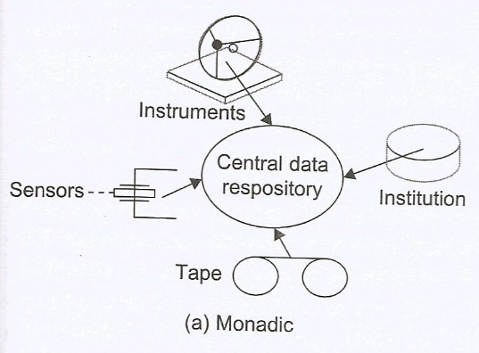
Monadic method
This is a centralized data repository model. All data is saved in central data repository.
When users want to access some data they have no submit request directly to the central repository.
No data is replicated for preserving data locality.
For a larger grid this model is not efficient in terms of performance and reliability.
Data replication is permitted in this model only when fault tolerance is demanded.

Slide 22
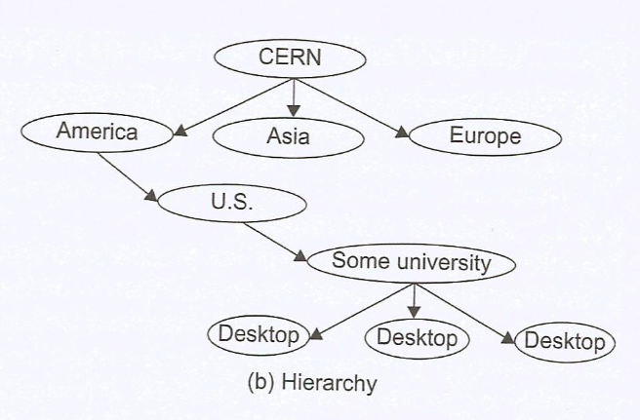
Hierarchical model
It is suitable for building a large data grid which has only one large data access directory
Data may be transferred from the source to a second level center. Then some data in the regional center is transferred to the third level centre.
After being forwarded several times specific data objects are accessed directly by users. Higher level data center has a wider coverage area.
PKI security services are easier to implement in this hierarchical data access model

Slide 23
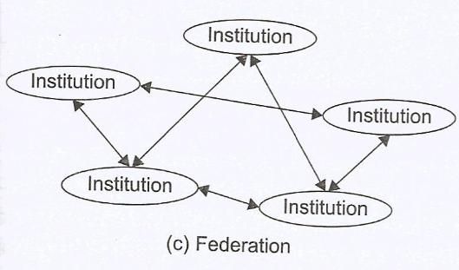
Federation model
It is suited for designing a data grid with multiple source of data supplies.
It is also known as a mesh model
The data is shared the data and items are owned and controlled by their original owners.
Only authenticated users are authorized to request data from any data source.
This mesh model cost the most when the number of grid intuitions becomes very large

Slide 24
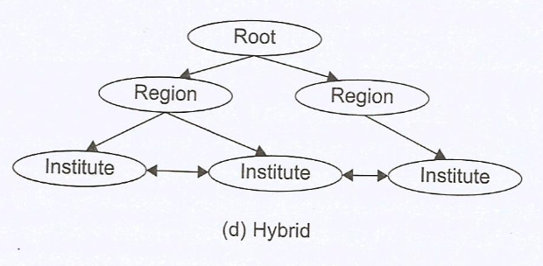
Hybrid model
This model combines the best features of the hierarchical and mesh models.
Traditional data transfer technology such as FTP applies for networks with lower bandwidth.
High bandwidth are exploited by high speed data transfer tools such as GridFTP developed with Globus library.
The cost of hybrid model can be traded off between the two extreme models of hierarchical and mesh-connected grids.

Slide 25
Parallel versus Striped Data Transfers
Parallel data transfer opens multiple data streams for passing subdivided segments of a file simultaneously. Although the speed of each stream is same as in sequential streaming, the total time to move data in all streams can be significantly reduced compared to FTP transfer.
Striped data transfer a data objects is partitioned into a number of sections and each section is placed in an individual site in a data grid. When a user requests this piece of data, a data stream is created for each site in a data gird. When user requests this piece of data, data stream is created for each site, and all the sections of data objects ate transected simultaneously.

Slide 26
Grid Services and OGSA
Facilitate use and management of resources across distributed, heterogeneous environments
Deliver seamless QoS
Define open, published interfaces in order to provide interoperability of diverse resources
Exploit industry-standard integration technologies
Develop standards that achieve interoperability
Integrate, virtualize, and manage services and resources in a distributed, heterogeneous environment
Deliver functionality as loosely coupled, interacting services aligned with industry- accepted web service standards

Slide 27
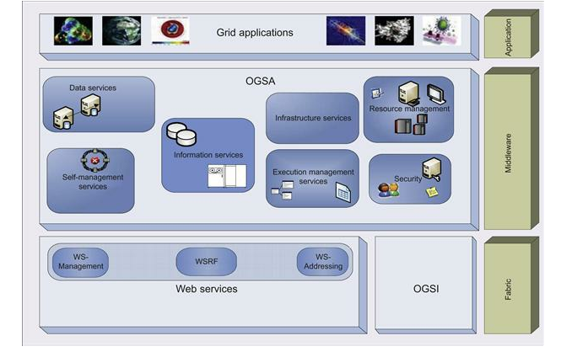
OGSA services fall into seven broad areas, defined in terms of capabilities frequently required in a grid scenario. Figure shows the OGSA architecture. These services are summarized as follows:

Slide 28
OGSA services - seven broad areas
Infrastructure Services Refer to a set of common functionalities, such as naming, typically required by higher level services.
Execution Management Services Concerned with issues such as starting and managing tasks, including placement, provisioning, and life-cycle management. Tasks may range from simple j obs to complex workflows or composite services.
Data Management Services Provide functionality to move data to where it is needed, maintain replicated copies, run queries and updates, and transform data into new formats. These services must handle issues such as data consistency, persistency, and integrity. An OGSA data service is a web service that implements one or more of the base data interfaces to enable access to, and management of, data resources in a distributed environment. The three base interfaces, Da ta Access, Da ta Fa ctory, and Da ta Ma na gement, define basic operations for representing, accessing, creating, and managing data.

Slide 29
OGSA services - seven broad areas
Resource Management Services Provide management capabilities for grid resources: management of the resources themselves, management of the resources as grid components, and management of the OGSA infrastructure. For example, resources can be monitored, reserved, deployed, and configured as needed to meet application QoS requirements. I t also requires an information model (semantics) and data model (representation) of the grid resources and services.
Security Services Facilitate the enforcement of security-related policies within a (virtual) organization, and supports safe resource sharing. Authentication, authorization, and integrity assurance are essential functionalities provided by these services.

Slide 30
OGSA services - seven broad areas
Information Services Provide efficient production of, and access to, information about the grid and its constituent resources. The term “information” refers to dynamic data or events used for status monitoring; relatively static data used for discovery; and any data that is logged. Troubleshooting is j ust one of the possible uses for information provided by these services.
Self-Management Services Support service-level attainment for a set of services (or resources), with as much automation as possible, to reduce the costs and complexity of managing the system. These services are essential in addressing the increasing complexity of owning and operating an I T infrastructure.

